Slide 1
Game Development In Computing
Usama Bin Imran

Slide 2
Agenda
Introduction
Game Design
Game Programming
Game Graphics and Rendering
Physics Simulation
User Interface (UI) and User Experience (UX) Design
Game Audio
Game Testing and Quality Assurance
Conclusion

Slide 3
Introduction
Interactive and Digital Experience.
Multidisciplinary Collaboration.
Significant growth in recent years.
Opportunities for independent developers.
Technological Advancements.
Player Experience and Engagement.

Slide 4
Game Design
What would be the game design elements for any game development?
Game Concept
Gameplay Mechanics
Storytelling and Narrative
User Experience (UX) Design
Balancing and Iteration
Level and World Design
Game Objectives
Characters (playable or non-playable)
Accessibility
Audio and Video Design

Slide 5
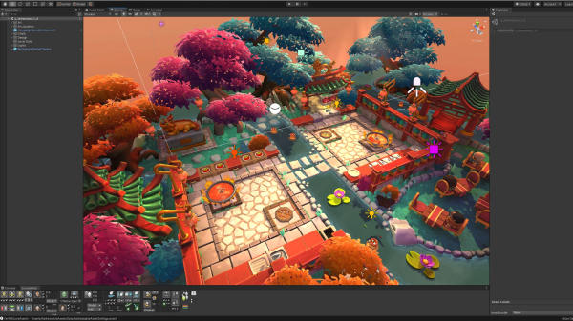

Slide 6
Game Programming
Gameplay Mechanics:
Performance Optimization
Debugging and Testing
Engine Integration
Asset Management
Write code for character behavior, controls, AI, physics, and game rules.
User Interface Design
Handle loading, rendering, and integration of 3D models, textures, animations, and audio.
Develop code for menus, HUDs, and GUI elements for player interaction.
Optimize code for smooth performance, responsiveness, and memory usage.
Identify and fix bugs through systematic testing and debugging tools.
Utilize game engines like Unity or Unreal Engine for streamlined development and pre-built functionalities.

Slide 7
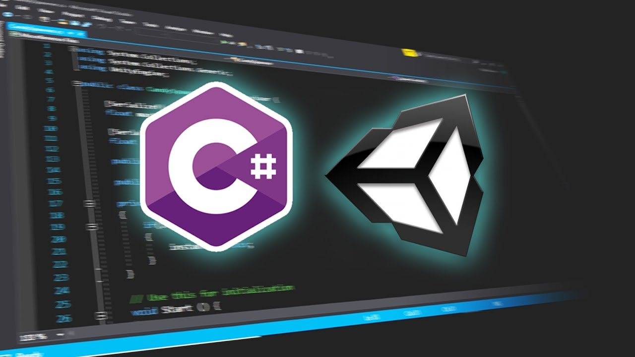

Slide 8
Game Graphics and Rendering
Graphic Design: Creating or acquiring visual assets such as models, textures, animations, and UI elements.
Rendering Techniques: Applying effects and transformations to 3D models for display on a 2D screen.
Rendering Pipeline: Series of processes converting 3D scene data into final 2D images.
Graphics APIs: Utilizing APIs like DirectX or OpenGL to optimize rendering performance.
Optimization: Enhancing graphics and rendering for smooth frame rates and efficient resource usage.
Art Pipeline Integration: Collaborating with artists to integrate graphics assets into the game engine.

Slide 9


Slide 10
Physics Simulation
Collision Detection: Detecting and handling object collisions in the game world.
Object Movement and Dynamics: Simulating object movement and behavior based on physical properties.
Gravity and Physics Forces: Applying gravity and other forces to objects.
Ragdoll Physics and Character Animation: Simulating character movement and interactions using ragdoll physics.
Vehicle Physics: Implementing realistic physics for vehicles in driving or flying simulations.
Fluid Dynamics: Simulating the behavior of fluids in the game world.
It refers to the implementation of realistic physical behaviors and interactions within a virtual game world.
Applying principles of physics such as
gravity,
collision detection, and
object movement,
Representing the movement, interaction, and dynamics of objects and characters within the game environment.

Slide 11
User Interface (UI) and User Experience (UX) Design
UX Design
Menu Design
HUD Design
Controls and Input Design
User Interface (UI) and User Experience (UX) Design
Creating visually appealing and functional elements, menus, and controls for easy game navigation and access to features.
Focusing on the overall player experience, considering gameplay flow, engagement, and emotional satisfaction.
Creating functional and visually appealing menus for easy navigation.
Developing intuitive and responsive controls.
Designing informative and unobtrusive heads-up displays.
UI Design
Feedback Systems
Implementing visual and audio feedback mechanisms.
User Interface (UI) and User Experience (UX) design in game development focus on creating intuitive and enjoyable interactions between players and the game.

Slide 12
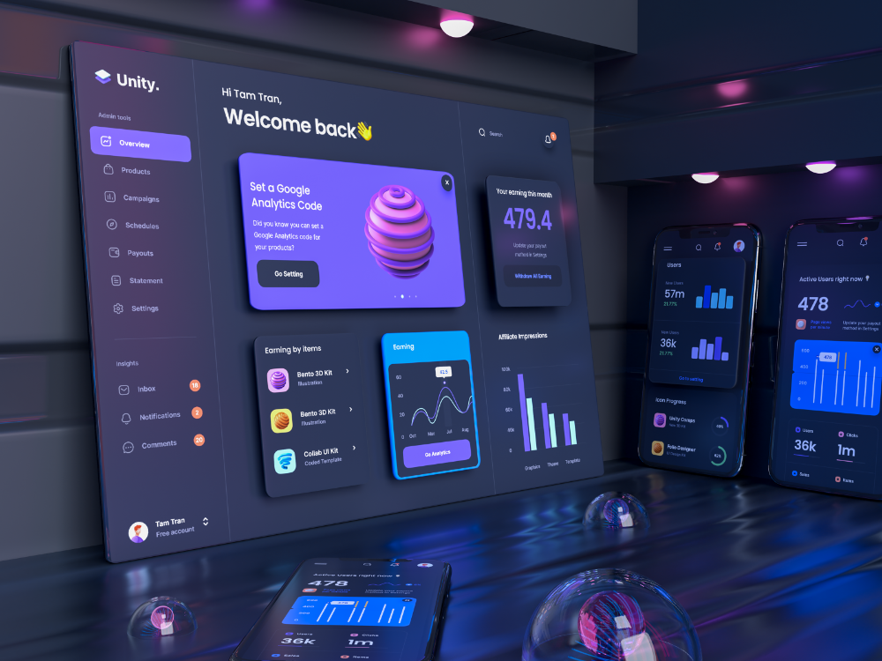

Slide 13
Game Audio
Sound Effects: Design and implement immersive in-game sounds like footsteps, explosions, and environmental effects.
Music Composition: Create original music tracks that enhance gameplay and evoke emotions.
Voiceover and Dialogue: Record and integrate voice performances and dialogue to bring characters and stories to life.
Audio Integration: Implement audio assets with proper timing, synchronization, and spatial positioning for a realistic experience.
Audio Middleware: Utilize tools and libraries to facilitate the integration and management of audio assets.
Audio Optimization: Optimize audio assets and systems for efficient memory usage and performance.
Audio Testing and Quality Assurance: Thoroughly test audio assets to ensure synchronization and high-quality player experience.
Game Audio refers to the sound and music elements in game development that enhance the player's immersion and overall experience. It involves creating, integrating, and managing audio assets within the game.

Slide 14
Game Testing and Quality Assurance
Functional Testing
Compatibility Testing
Performance Testing
Regression Testing
Usability Testing
Verify game features
Ensure smooth operation across platforms and devices.
Evaluate frame rate
loading times
Ensure resolved issues haven't resurfaced.
Assess UI
controls
user experience.
resource usage.
mechanics
interactions.
Game Testing and Quality Assurance (QA) in game development involves the systematic process of evaluating a game's functionality, performance, and overall quality to ensure it meets the desired standards and delivers a smooth and enjoyable player experience.

Slide 15
Game Testing and Quality Assurance
Multiplayer and Network Testing
Localization Testing
Compliance and Certification Testing
Bug Tracking and Reporting
Playtesting and User Feedback
Test online functionality
Verify accurate translation
Ensure adherence to standards and guidelines.
Identify and document issues.
Gather player insights for improvement.
Test synchronization.
Cultural appropriateness.

Slide 16
Conclusion
Game design
Game graphics and rendering
Physics simulation
UI/UX design
Game audio
Testing and QA
Game programming
Conceptualize, define mechanics, design levels, and develop narratives.
Implement mechanics, manage assets, design interfaces, optimize performance, and debug code.
Create/acquire assets, apply rendering techniques, optimize performance, integrate art assets.
Handle collision detection, object movement, dynamics, gravity, vehicle physics, and fluid dynamics.
Create intuitive interfaces, smooth navigation, provide feedback, optimize player experience.
Design sound effects, compose music, integrate voiceover/dialogue, optimize audio assets.
Ensure functionality, compatibility, performance, usability, localization, compliance, bug tracking, and user feedback gathering.

Slide 17
Thank you

